Slide 1
Winter Term 22-23 Meta-Reinforcement Learning for Self-Adaptive Systems Lecture-6: Multi-Task Learning
Prof. Dr. Holger Giese (holger.giese@hpi.uni-potsdam.de)
Christian Medeiros Adriano (christian.adriano@hpi.de) - “Chris”
He Xu (he.xu@hpi.de)
Sona.Ghahremani (sona.ghahremani@hpi.de)

Slide 2
Data is the new oil - Clive Humby, 2006
“Data is the new oil. Like oil, data is valuable, but if unrefined it cannot really be used. It has to be changed into gas, plastic, chemicals, etc. to create a valuable entity that drives profitable activity. so, must data be broken down, analysed for it to have value.”
Clive Humby, 2006– Mathematician [1]
The cheap access to plenty of data propped up the Deep Learning revolution in image recognition and natural language processing, because Deep Neural Nets require a lot of data to be trained to generalize beyond the training sets.
[1] https://medium.com/project-2030/data-is-the-new-oil-a-ludicrous-proposition-1d91bba4f294#.vjyvcwnp0

Slide 3
Generalization in Dynamic Environments
However, tasks in dynamic environments are subject to:
data sparsity (e.g., long tail distributions)
adversarial changes (e.g., shift in distributions)
The consequence is that models need to be retrained from scratch, which:
requires a lot of data which are not possible to collect
might be too slow for dynamic environments needs

Slide 4
Generalization in Dynamic Environments
Foundation models (GPT3, BERT, etc.)[1,2] mitigated this generalization problem for image and text data via brute-force training neural networks with billions of parameters.
However, we do not enough and diverse data when working in specialized dynamical environments that:
rely on spatio-temporal data (e.g., sensor networks, graph-databases)
present safety-critical requirements (e.g., robotics, traffic, autonomous vehicles).
[1] IBM, 2022, https://research.ibm.com/blog/what-are-foundation-models
[2] Bommasani, Rishi, et al. , 2021, "On the opportunities and risks of foundation models." arXiv preprint arXiv:2108.07258

Slide 5
Generalization Desiderata
Learn tasks for general purpose systems (task reuse and composition)
Learn from small data increments (update beliefs without catastrophic forgetting)
Robust to adversarial changes (smooth degradation for OOD data)
Safe and Fair decisions over sparse state-spaces (self-recovery, self-protecting)
Ultimately, we need methods that allow to make explicit generalization trade-offs between:
Cost (Diversity and quantity of data)
Risk (Uncertainty of predictions)
Speed (Time to train a new model)
Quality (Accuracy of predictions)

Slide 6
Data set | Size
ImageNet | 1.2 million images and labels
WMT’14 English-French | 40.8 million paired sentences
Switchboard Speech Dataset | 300 h of labeled data
Kaggle’s Diabetic Retinopathy Detection Dataset | 35k labeled images
Adaptive epilepsy treatment with RL | <1 hours data
Learning from robotic manipulation | <15 min of data
source: C. Finn, 2021, CS 330 Lecture-1

Slide 7
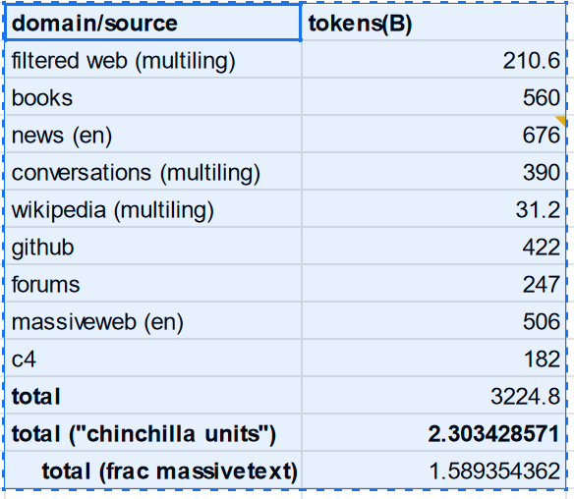
Are we running out of data? [1]
Quoting [1]:
“The Pile's scrape had 631GB of text, and ~299B tokens
The MassiveText scrape had 3.1TB of text, and 506B tokens
The PaLM scrape had only 196GB of text (we aren't told how many tokens)
The Codex paper's scrape was python-only and had 159GB of text”
Overall
3.1 T tokens of text
1 T token of source code
[1] Nostalgebraist, 2022, Chinchilla’s Wild Implications, in LessWrong. https://www.lesswrong.com/posts/6Fpvch8RR29qLEWNH/chinchilla-s-wild-implications#2__are_we_running_out_of_data

Slide 8
Approaches to generalization
Learn multiple tasks (Multi-task learning) [Zhang & Yang 2021]
Learning to Learn from Experience (Meta-Learning) [Zhuang et al. 2020]
Learn from previous tasks (Transfer learning) [Hospedales et al. 2021]
Similar Goals
Multi-task learning: learn tasks more quickly and more effectively (higher accuracy) than learning tasks individually and independently.
Meta-learning: given experience (data) from previous tasks, learn a new task more quickly and effectively
Transfer learning: similar to meta-learning, but focuses on one source task and one target task.
Zhang, Yu, and Qiang Yang. "A survey on multi-task learning." IEEE Transactions on Knowledge and Data Engineering (2021).
Zhuang, Fuzhen, et al. "A comprehensive survey on transfer learning." Proceedings of the IEEE 109.1 (2020): 43-76.
Hospedales, Timothy, et al. "Meta-learning in neural networks: A survey." IEEE transactions on pattern analysis and machine intelligence 44.9 (2021): 5149-5169.
Notes:
https://youtu.be/dYmJd_fJLW0?list=PLoROMvodv4rMIJ-TvblAIkw28Wxi27B36&t=2842

Slide 9
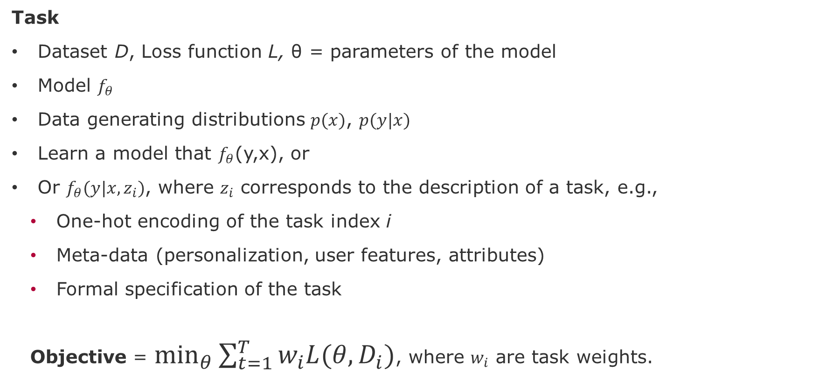
Multi-task learning - Definitions and notations
Task
Dataset D, Loss function L, θ = parameters of the model
Model $f_{θ}$
Data generating distributions $p(x)$, $p(y|x)$
Learn a model that $f_{θ}$(y,x), or
Or $f_{θ}(y|x,z_{i})$, where $z_{i}$ corresponds to the description of a task, e.g.,
One-hot encoding of the task index i
Meta-data (personalization, user features, attributes)
Formal specification of the task
Objective = $\min_{θ}{\sum_{t=1}^{T}{w_{i}L(θ,D_{i})}}$, where $w_{i}$ are task weights.
source: C. Finn, 2021, CS 330 - https://cs330.stanford.edu/

Slide 10
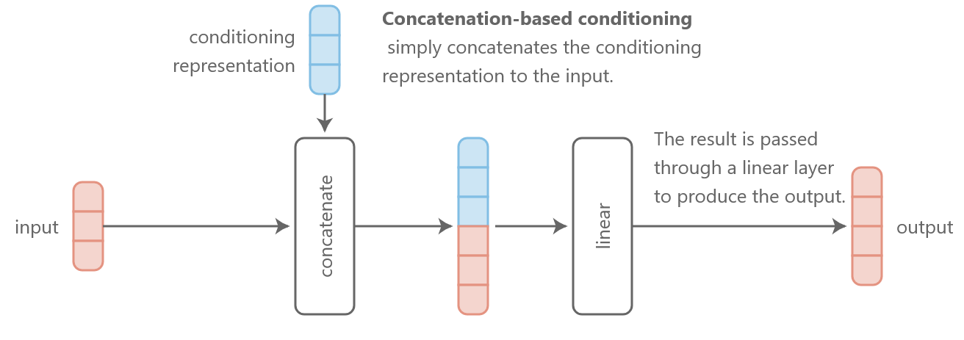
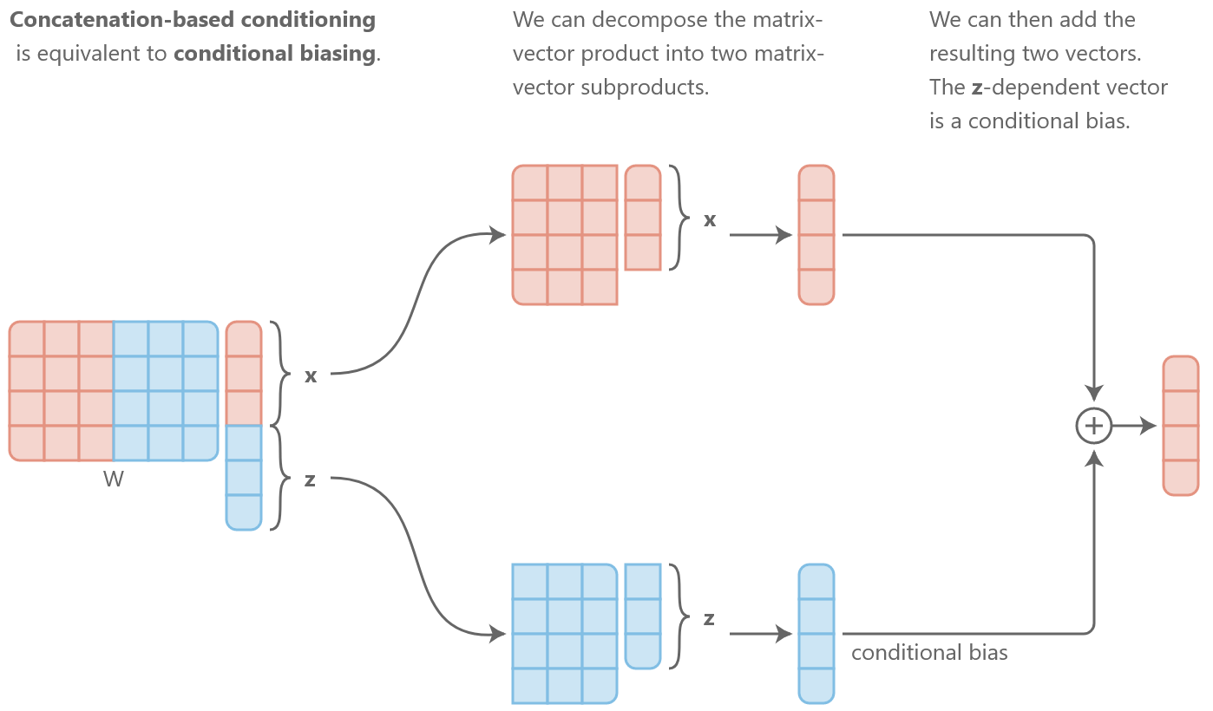
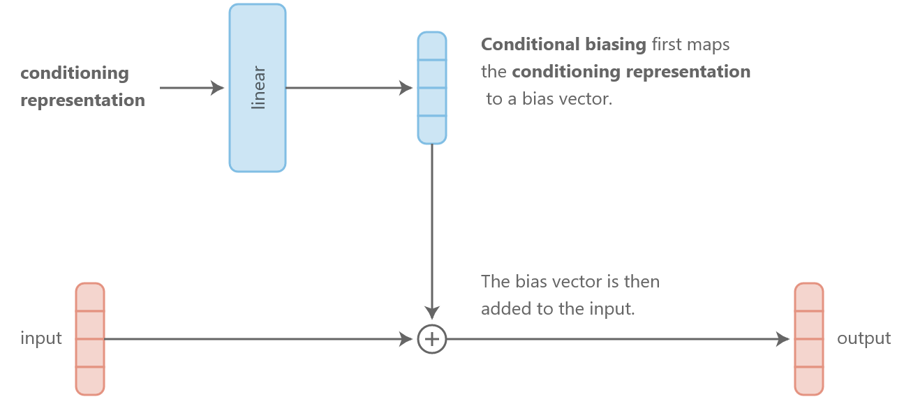

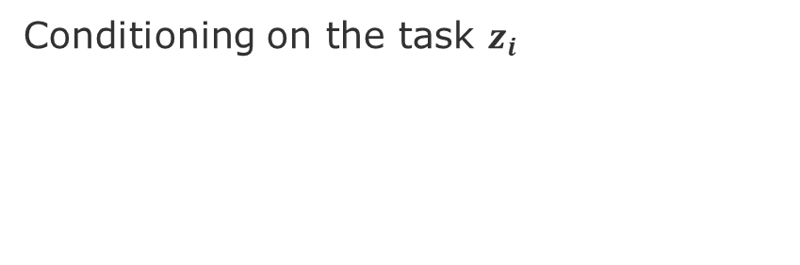


Multi-Task Learning – Model Architecture
Concatenate-based
Conditioning on the task $z_{i}$
Equivalent to concatenation + fully connected layer
$$z_{i}$$
Additive-based
$$z_{i}$$
$$z_{i}$$
Other options:
Multi-Head Attention
Multiplicative Conditioning
Or more complex choices [1]
source: https://distill.pub/2018/feature-wise-transformations/
[1] see slide 15,lecture-2 in C. Finn, CS330, 2021

Slide 11
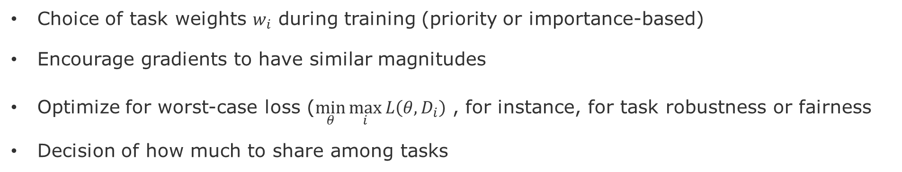
Challenges and Solutions
Choice of task weights $w_{i}$ during training (priority or importance-based)
Encourage gradients to have similar magnitudes
Optimize for worst-case loss ($\min_{θ}{\max_{i}{L\left(θ,D_{i}\right)}}$ , for instance, for task robustness or fairness
Decision of how much to share among tasks

Slide 12
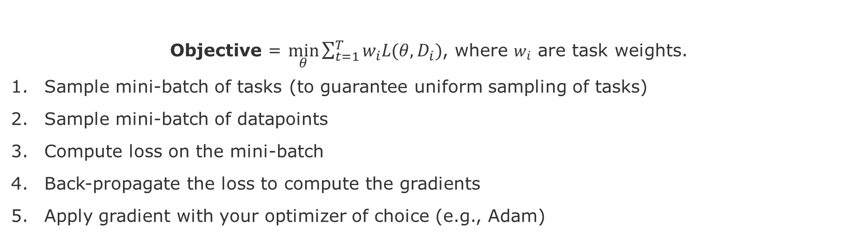
Optimization step-by-step
Objective = $\min_{θ}{\sum_{t=1}^{T}{w_{i}L(θ,D_{i})}}$, where $w_{i}$ are task weights.
Sample mini-batch of tasks (to guarantee uniform sampling of tasks)
Sample mini-batch of datapoints
Compute loss on the mini-batch
Back-propagate the loss to compute the gradients
Apply gradient with your optimizer of choice (e.g., Adam)
source: lecture-2 in C. Finn, CS330, 2021

Slide 13
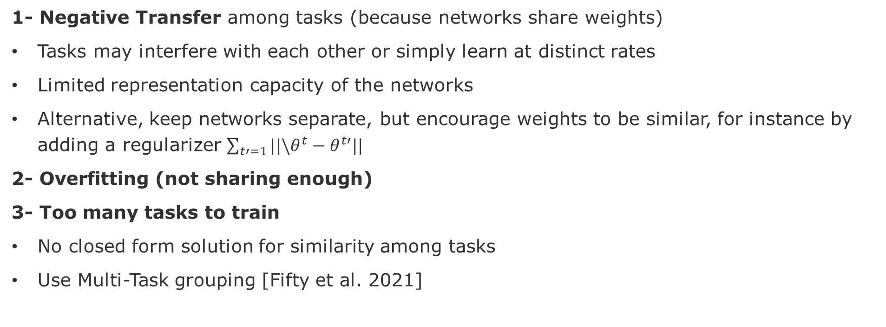
Challenges
1- Negative Transfer among tasks (because networks share weights)
Tasks may interfere with each other or simply learn at distinct rates
Limited representation capacity of the networks
Alternative, keep networks separate, but encourage weights to be similar, for instance by adding a regularizer $\sum_{t′=1}{||\backslash θ^{t}−θ^{t′}||}$
2- Overfitting (not sharing enough)
3- Too many tasks to train
No closed form solution for similarity among tasks
Use Multi-Task grouping [Fifty et al. 2021]
Fifty, Chris, et al. "Efficiently identifying task groupings for multi-task learning." Advances in Neural Information Processing Systems 34 (2021): 27503-27516.

Slide 14
Multi-Task Reinforcement Learning

Slide 15
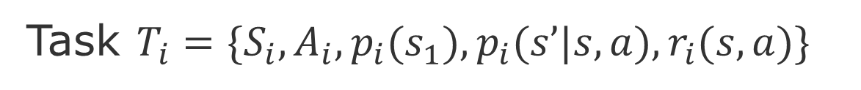
What is a task in Reinforcement Learning
action space
environment dynamics
Task $T_{i}=\{S_{i}, A_{i}, p_{i}(s_{1}),p_{i}(s’|s,a),r_{i}(s,a)\}$
state space
initial state distribution
reward
It can be modeled as a Markov Decision Process
Task identifier is part of the state $s=(\overline{s},z_{i})$
$\left\{T_{i}\right\}≜\{∪S_{i}, ∪A_{i},\frac{1}{N}\sum_{i}{, p_{i}\left(s_{1}\right),}p_{i}\left(s’ | s,a\right),r_{i}\left(s,a\right)\}$
source: Stanford CS330: Deep Multi-task & Meta Learning I 2021 I Lecture 9
Notes:
https://youtu.be/_ND7muYS9qY?list=PLoROMvodv4rMIJ-TvblAIkw28Wxi27B36&t=3011

Slide 16
Benefits of Multi-Task RL
Cross-task generalization
Easier exploration
Sequencing for long-horizon tasks
Reset-free learning
Per-task sample-efficiency gains

Slide 17
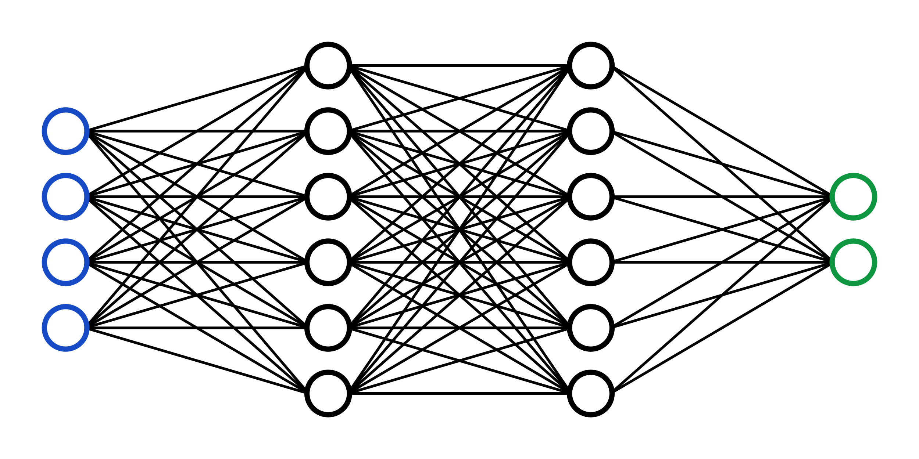
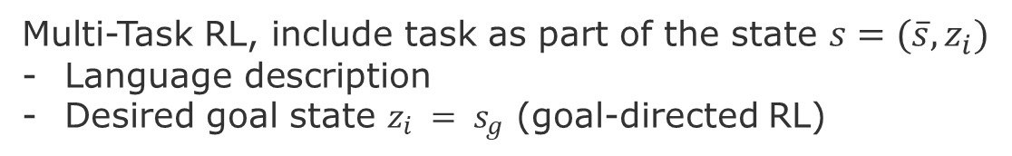


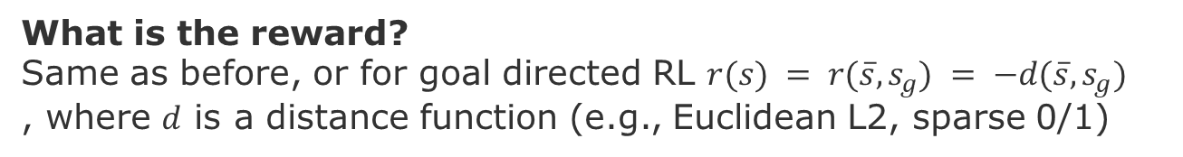
Goal of Multi-Task RL
Multi-Task RL, include task as part of the state $s=(\overline{s},z_{i})$
Language description
Desired goal state $z_{i} = s_{g}$ (goal-directed RL)
Action
Agent
$π_{θ}(a|s)$
Environment
$$p(s^{′}|s,a)$$
State
Reward
What is the reward?
Same as before, or for goal directed RL $r(s) = r(\overline{s},s_{g}) = −d(\overline{s},s_{g})$
, where $d$ is a distance function (e.g., Euclidean L2, sparse 0/1)
source: Stanford CS330: Deep Multi-task & Meta Learning I 2021 I Lecture 9
Notes:
https://youtu.be/_ND7muYS9qY?list=PLoROMvodv4rMIJ-TvblAIkw28Wxi27B36&t=3011

Slide 18
Next Tasks (Tuesday, Nov. 8)
Task-1 Multi-Task Q-Learning
Stanford CS330: Deep Multi-task & Meta Learning I 2021 I Lecture 9
https://youtu.be/_ND7muYS9qY?list=PLoROMvodv4rMIJ-TvblAIkw28Wxi27B36&t=2891
Sodhani, Shagun, Amy Zhang, and Joelle Pineau. "Multi-task reinforcement learning with context-based representations." International Conference on Machine Learning. PMLR, 2021.
Task-2 Goal-Conditioned Reinforcement Learning
Stanford CS330: Deep Multi-task & Meta Learning I 2021 I Lecture 9
https://youtu.be/_ND7muYS9qY?list=PLoROMvodv4rMIJ-TvblAIkw28Wxi27B36&t=4545
Liu, Minghuan, Menghui Zhu, and Weinan Zhang. "Goal-conditioned reinforcement learning: Problems and solutions." arXiv preprint arXiv:2201.08299 (2022).

Slide 19
Take-away for our project
Assuming a learned policy that optimizes for both traffic and CO2 emissions, learn tasks that optimize for fairness and safety.
Fairness consists of limiting the imbalance between the size of waiting queues in a traffic crossing, for instance, not allowing that on average the smaller roads have queues larger than a certain threshold for longer than number of traffic light cycles.
Safety consists of limiting the speed of certain lanes (hence allowing queues to grow) during certain times of the day, for instance, drop and picking up time of school children.
To start thinking:
How could we model the task of choosing the traffic light, how to condition on the contextual variables?
Which parameters of the task model should be shared (to promote transfer between tasks)?
How should we form the objective function?
How should we optimize it?

Slide 20
Resources
Prof. Dr. Chelsea Finn CS 330: Deep Multi-Task and Meta Learning: https://cs330.stanford.edu Fall 2021 Lectures: https://www.youtube.com/playlist?list=PLoROMvodv4rMIJ-TvblAIkw28Wxi27B36 Multi-Task, Transfer-Learning, Meta-Learning, Hierarchical and Bayesian Methods for Deep Learning
Surveys Zhang, Yu, and Qiang Yang. "A survey on multi-task learning." IEEE Transactions on Knowledge and Data Engineering (2021). Zhuang, Fuzhen, et al. "A comprehensive survey on transfer learning." Proceedings of the IEEE 109.1 (2020): 43-76. Hospedales, Timothy, et al. "Meta-learning in neural networks: A survey." IEEE transactions on pattern analysis and machine intelligence 44.9 (2021): 5149-5169. Liu, Minghuan, Menghui Zhu, and Weinan Zhang. "Goal-conditioned reinforcement learning: Problems and solutions." arXiv preprint arXiv:2201.08299 (2022). Sodhani, Shagun, Amy Zhang, and Joelle Pineau. "Multi-task reinforcement learning with context-based representations." International Conference on Machine Learning. PMLR, 2021.

